Slide 1
A Study of Uncertainty
in the LIDC
Jake Sauter, Victoria LaBarre,
Jacob Furst and Daniela Raicu
Notes:
Hi I’m Victoria, this is Jake, and this is our final presentation

Slide 2
Overview:
Study 1
Introduction
Motivation
Methodology
Results
Conclusion
Study 2
Methodology
Results
Notes:
As an overview of what we will be covering today, first we split our presentation into two parts: study 1 and study 2. Study 1 is our completed study of consensus techniques compared on two different classifiers and study 2 is the uncompleted study that we will be leaving for next year’s students to complete, concerning what defines an atypical nodule in the LIDC and whether identifying such nodules can improve the accuracy of CAD systems.

Slide 3
Study 1
An Evaluation of Consensus Techniques for Diagnostic Interpretation
Notes:
Read slide

Slide 4
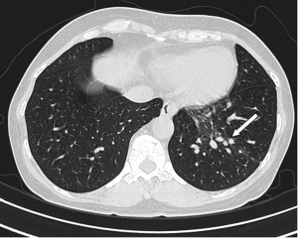
Introduction
Lung cancer
Computer-aided diagnosis (CAD)
Variance in Ground Truth
Mean consensus is the best technique to form ground truth with
Figure 1: Lung Nodules in a Radiographic Image

Slide 5
Literature Review:
Lung Image Database Consortium: Developing a Resource for the Medical Imaging Research Community. Radiology
Computer-Aided Diagnosis of Lung Nodules in Computed Tomography by Using Phylogenetic Diversity,Genetic Algorithm, and SVM

Slide 6
Motivation
LIDC Data
Consensus-based Label Extraction
Mean, Median, Mode
Classification Models
Hierarchy of Information Loss

Slide 7
PLV
No loss of information
Accuracy undefined
Lose a little information
Accuracy defined
Label (1-5)
Binary
Lose more information
ROC, H-Measure, sensitivity, specificity...

Slide 8
Methodology
Belief
Decision
tree
Vote Vector Conversion
LIDC dataset
Evaluation

Slide 9
Methodology
LIDC
Features Votes
Belief
Decision
tree
Vote Vector Conversion
Evaluation
Case 1
.
.
.
Case N
Case 1
.
.
.
Case N

Slide 10
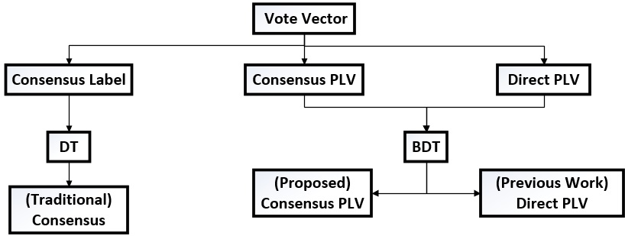
Methodology: Context

Slide 11
Methodology: Vote Vector Conversion
Vote vector
Example: [2, 2, 3, 5]
Converted using an consensus technique
Mean, median, mode
Probabilistic label vector
Example of a Median PLV: [ 0, 0.5, 0.5, 0, 0]
Sum equal to one
Percentage

Slide 12
Methodology: Vote Vector Conversion
Mean
[ 2, 2, 3, 5] [ 0, 0, 1, 0, 0]
2+2+3+5
= 3
4
Median
[ 2, 2, 3, 5] [ 0, 0.5, 0.5, 0, 0]
[ 2, 2, 3, 5]
= 2.5
Mode
[ 2, 2, 3, 5] [ 0, 1, 0, 0, 0]
[ 2, 2, 3, 5] = 2

Slide 13
Methodology: Label Extraction
Mean
[ .1,.1, .4, .2, .2]
1*.1+2*.1+3*.4+4*.2+5*.2 = 3.3
3
Median
3
[ .1,.1, .4, .2, .2]
RS: [.1, .2, .6, .8, 1]
Mode
[ .1,.1, .4, .2, .2]
3

Slide 14
Results:
Compared consensus techniques
Mean, Median, Mode
Compared forcing a label before/after
Multi Class Decision Tree (MCDT)
Belief Decision Tree (BDT)
Compared consensus techniques to distribution(BDT)
Consensus provided better positive to negative response rate

Slide 15
Results: before looking at our chart
DT- Decision Tree
BDT- Belief decision Tree
Mean, Median, Mode, Distribution
Green- correct
Red- incorrect
Negatives on the left
Positives on the right

Slide 16
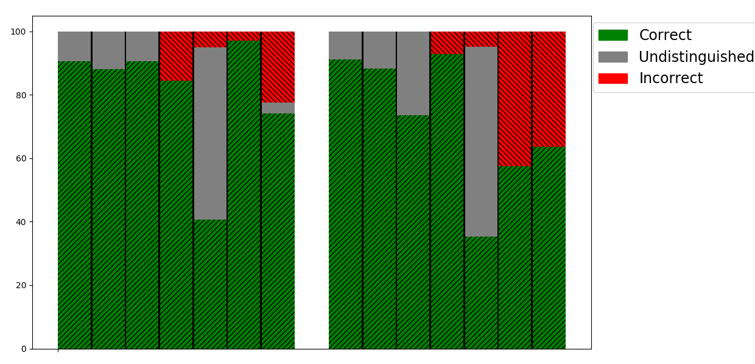
Negatives
Positives
|------MCDT-----
|----------BDT----------|
|------MCDT-----
|----------BDT----------|
Mean
Median
Mode
Mean
Median
Mode
Mean
Median
Mode
Mean
Median
Mode
Distribution
Distribution

Slide 17
Conclusions
Consensus produced more robust results
Consensus before model
better than consensus after model
Mean is the best technique
Most positive responses to negative responses

Slide 18
Study 2
An evaluation of feature characteristics of atypical nodules

Slide 19
Methodology: Support
Typical: There are “enough” similar nodules in the data
Atypical: the nodule is “significantly” different from the other nodules

Slide 20
Methodology: Support
3 Strategies:
Based on labels predicted using BDT’s
Based on image features
Combinations the above strategies

Slide 21
Support
3
Training Set
Testing Set
Support =
7
Actual Predicted
Predicted
= 0.43
1
1
[0, 0, 0.75, 0.25, 0]
....
...
[0, 0, 0, 0,1]
...
...
[0.25, 0.25, 0.25, 0.25, 0]
[0, 0, 1, 0, 0]
...
...
[0, 0, 1, 0, 0]
...
...
[0, 0, 1, 0, 0]
[0, 0, 1, 0, 0]
...
...
...
...
...
Case N
* 43% Support
2
2
3
4
5
6
3
7
# of total cases
# of matching predicted values

Slide 22
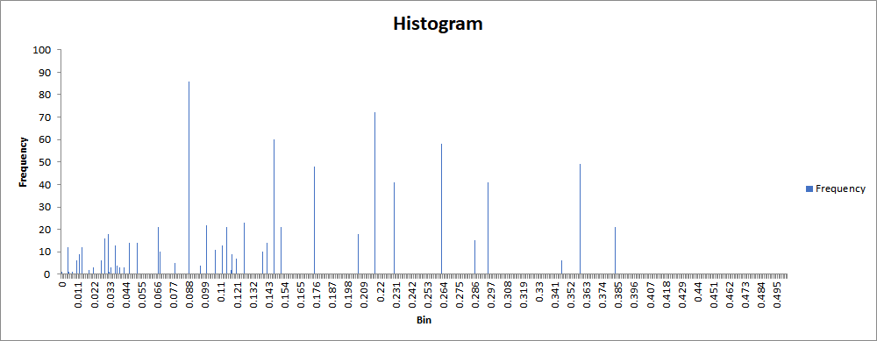
Results: Mean
10%
15%
20%
25%
Notes:
0.012…... 10%, 0.046……. 15%, 0.066…... 20%, 0.086……. 25%

Slide 23
Results: Discerning Features
Atypical nodules tend to be:
Less solid
Larger
Less circular
Less elongated
Higher entropy
Notes:
Victoria

Slide 24
Results: Discerning Features
Looked for a discerning feature of typicality
No one feature seemed to be able to do so
Feature combinations necessary to determine atypical nodules
Extracted the rules of the decisions of atypical cases
values of feature combinations
Notes:
Victoria

Slide 25
Questions?

Slide 26
Feature Boxplots
Feature N
Typical
Atypical

Slide 27
Results: extracted rules from atypical nodules
Elongation < 1.230454272
gaborSD_0_1 < 5782.78
gabormean_3_1 > 59.0652
MaxIntensityBG > 485.3564']
MinorAxisLength > 1.230454272
SecondMoment < 0.170377481
markov1 > 271.5484
SDIntensity < 1412.0
noduleID > 154.0
gaborSD_0_0 < 1646.04
MinorAxisLength >1.241783503
Elongation < 1.390650159
gaborSD_3_1 < 41.1318
Notes:
Victoria

